Slide 1

Quick Reference Card Harmonized Customer Service Management Terminology
Owner: OCM
March, 2019

Slide 2
Disclaimer
The terminologies explained in this Quick Reference Card focus mainly on the Minimum Viable Product (MVP) for the Harmonized Customer Service Management (HCSM) project.
Definitions in the Quick Reference Card have been adjusted to the context of the HCSM project and may evolve and change as the project scope develops and expands.

Slide 3

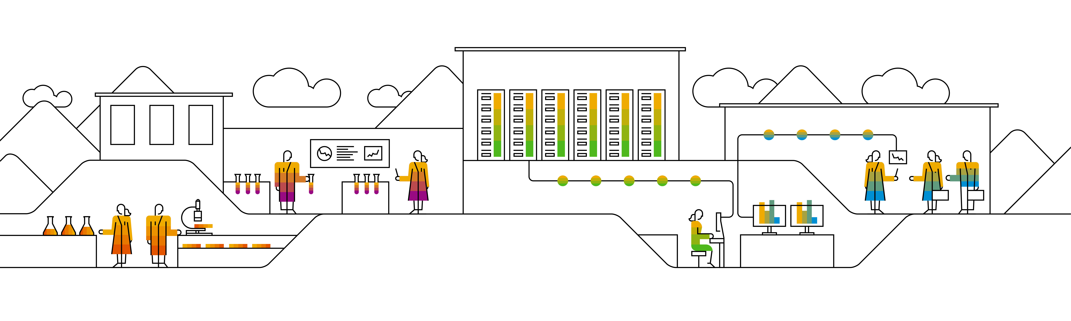



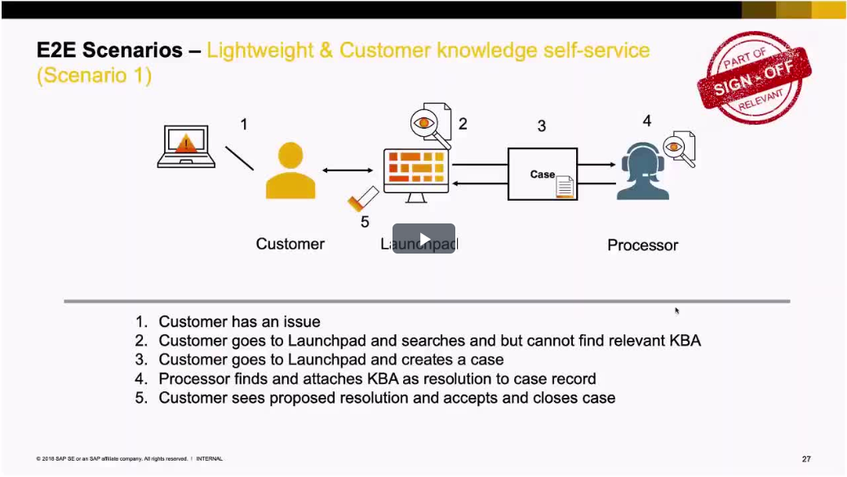
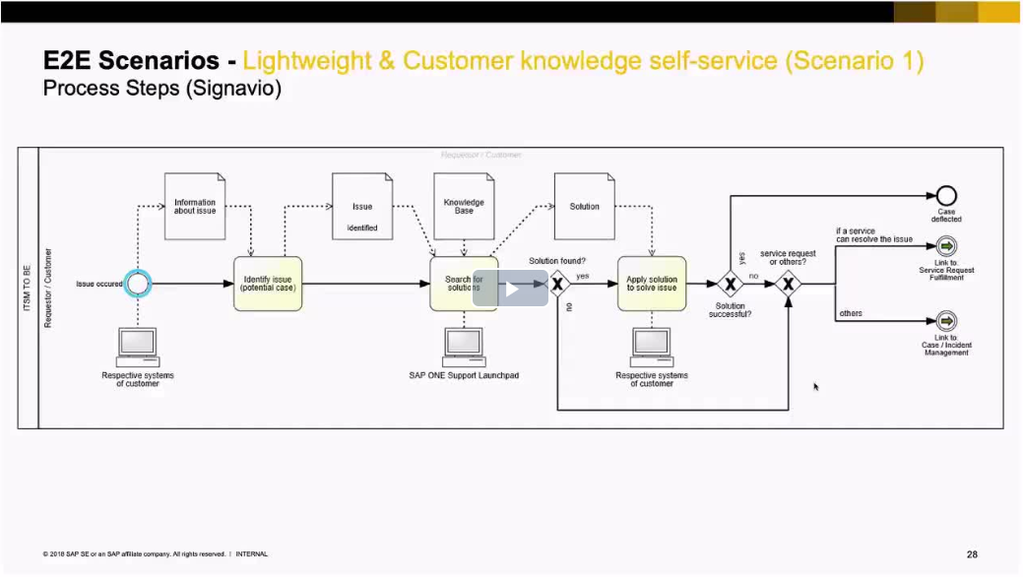


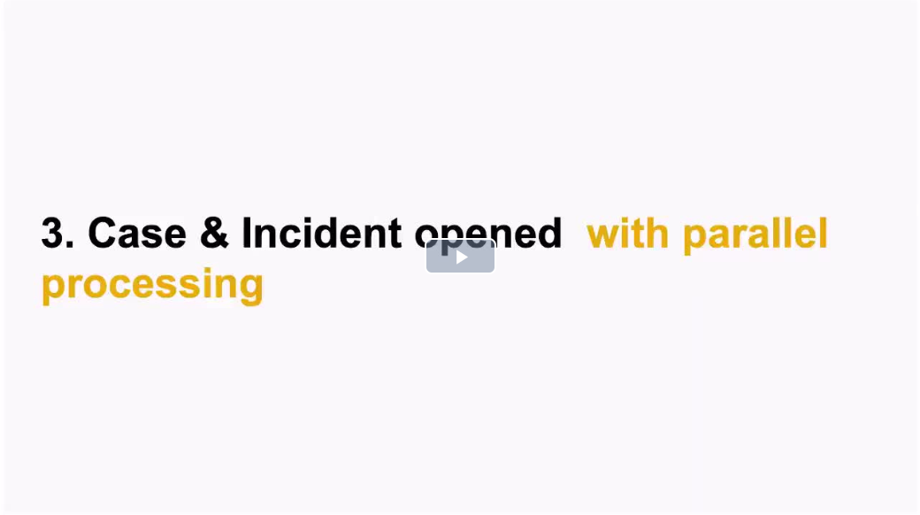
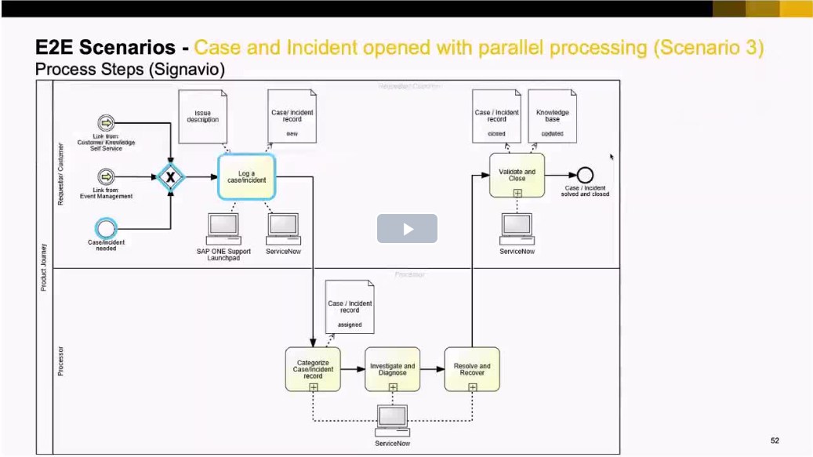
Harmonized Customer Service Management (HCSM) Terminology
Description
Explanation & Related Terms
Explanatory documents
Description
Definition
Case Record: Case record (commonly used as Case) is the primary customer-facing entity a customer service agent uses to identify and resolve a question or an issue for an external customer within the agreed Service Level Agreements (SLAs). Case can be resolved through workaround and/or permanent solution.
Incident Record: Incident record (commonly used as Incident) is the record type an agent or processor uses solely internally to identify and resolve: 1) an unplanned interruption or reduction in the quality of an IT service, 2) performance degradation or 3) failure of configuration item that has not yet affected the service. Incident record is used to recover the service to an acceptable level through workaround and/or permanent solution within contracted resolution time.
Case/Incident Management: Case/Incident Management is the process responsible for managing the lifecycle of all cases and/or incidents. The primary objective of Case/Incident Management is to restore the normal IT service operation to customers as quickly as possible and minimize the business impact.
Case Management
This document explains the terms Case Record, Incident Record, and Case/Incident Management.
Process Scenario
Explained [Video]
Process in Signavio
[Video]
Audience
Support, Development, and Operations
Prerequisites
Click on the picture to open the video
Click on the picture to open the video
Not applicable
Case/Incident Management
Overview
Process Scenario Explained [Video]
Process in Signavio
[Video]
Context
Case record is used for all customer-facing communication while incident is opened and processed internally.
A case record can be created via incident record to communicate with customers when necessary.
An incident record can be created via case record when non customer-facing teams need to be involved.
Click on the picture to open the video
Click on the picture to open the video

Slide 4
Harmonized Customer Service Management (HCSM) Terminology
Description
Explanation & Related Terms
Explanation & Related Terms
(Cont’d)
Description
Definition
Service Level Agreement (SLA): Service Level Agreement is an agreement between an IT service provider and an external customer for recurring IT services. It describes the quality and scope of the IT service, documents service level targets, and specifies the responsibilities of both parties. SLAs include segments such as system availability, reaction times, problem management, processing speed for cases, and disaster recovery scenarios. A single SLA may cover multiple IT services or multiple customers.
System Availability: System availability is the probability a system is functioning when needed to, under normal operating conditions.
Disaster Recovery: Disaster recovery is the process of getting a data center back to work after a failure due to disaster scenarios such as power problems, fire, or flood.
Initial Reaction Time (IRT): Initial Reaction Time, also known as Initial Response Time, is the time between a record arriving at SAP Support and the first qualified response provided to the customer.
Maximum Processing Time (MPT): Maximum Processing time is the maximum time a customer can expect a solution to be provided to the request. It is the time between record arriving at SAP Support and solution confirmed by customer, or if the case is automatically closed by the system, based on real time (24x7). MPT is paused when waiting for customer action or solution provided to customer.
Action Plan Time (APT): Action Plan Time is the time that starts when a record arrives at SAP support, contractually requiring the creation of an Action Plan (AP) or when the priority of existing case becomes APT contract relevant. APT is paused when waiting for customer action. It can also be stopped by Support Engineer if: 1) an AP is created and sent to customer, 2) the priority is lowered, 3) solution is provided, or 4) the case is confirmed and closed by customer.
Ongoing Response Time (ORT): Ongoing Response Time starts after the IRT is fulfilled and continues until the next update is sent to the customer. ORT is reset when case is sent back to SAP Support, paused when waiting for customer action and stopped when the case is resolved. ORT is calculated based on real time for Priorities 1 and 2 and office hours for Priorities 3 and 4.
This document explains the term Service Level Agreement and its related terms.
Audience
Support, Development, and Operations
Prerequisites
Refer to the Quick Reference Card for Case/Incident
Overview
Service Level Agreement (SLA) is part of the Enterprise Support contracts. Its main objectives are
Accelerate resolution processes
Minimize business disruption and unforeseen downtime
Help reduce financial impact of support issues.

Slide 5
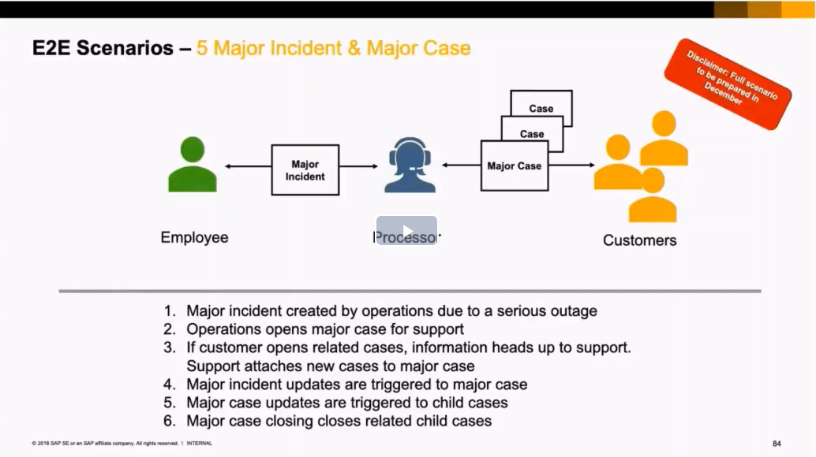
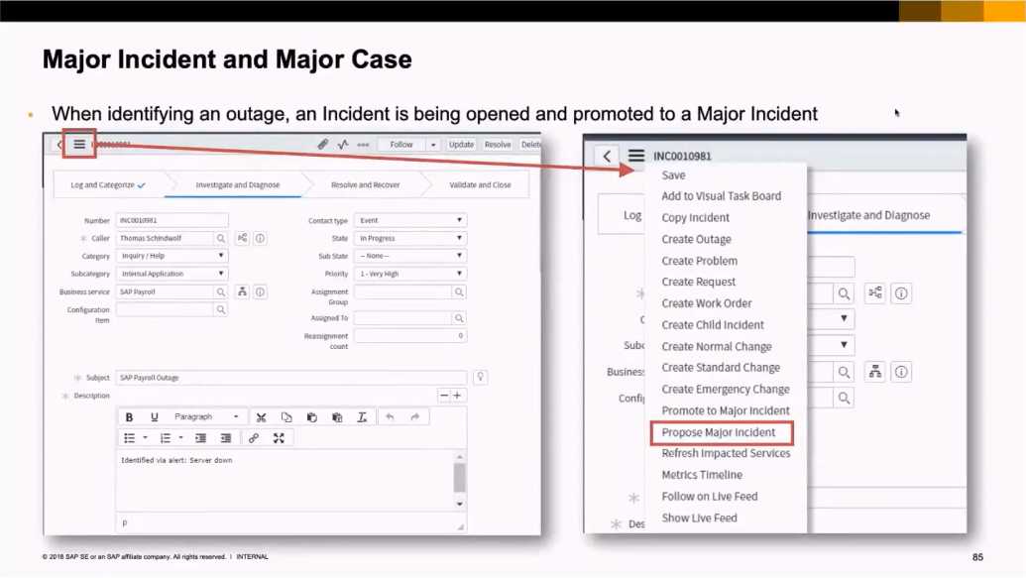
Harmonized Customer Service Management (HCSM) Terminology
Description
Explanation & Related Terms
Explanatory documents
Description
Definition
Major Case: Major case handles issues impacting a wider customer audience and is used to proactively manage the resolution process for an issue encountered by multiple customers at the same time. It is not associated with any accounts, contacts, or customers. The customer-specific information and communication reside in the associated related cases.
Major Incident: Major incident is the highest category of impact for an incident and results in significant disruption to the business or a business down situation. Major incident can be a parent incident when multiple child incidents can be related.
Child Incident: Child incident is the incident that has a direct relation to the parent incident due to the same root cause.
Parent Incident: Parent incident is an aggregation of child incidents that share the same root cause. It is used to ease the record handling and management in order to accelerate the incident progression and resolution. Updates within the parent incident are subsequently passed onto the associated child incidents.
Major Incident & Major Case Scenario Explained
This document explains the terms Major Case, Major Incident, Child Incident, and Parent Incident.
Audience
Support, Development, and Operations
Prerequisites
Click on the picture to open the video
Refer to the Quick Reference Card for Case/Incident
Major Incident & Major Case Showcase
Overview
Context
Major case is created by Operations when there are multiple cases from different customers reporting the same issue while major incident is created by Operations when there is serious service disruption.
The parent-child incident relationship is used when multiple (child) incidents have the same root cause in order to accelerate the incident progression by avoiding duplicate work on individual single records.
Click on the picture to open the video

Slide 6
Harmonized Customer Service Management (HCSM) Terminology
Description
Explanation & Related Terms
Explanation & Related Terms
(Cont’d)
Description
This document explains the terms Knowledge Base, Knowledge Base Article, SAP Notes, and Knowledge Management.
Definition
Knowledge Base: Knowledge Base is a logical database containing and structuring the data used by the Service Knowledge Management System.
Knowledge Base Article (KBA): Knowledge Based Article is a unique article created and updated by SAP employees and available to customers with note access on the Service Marketplace. KBAs contain information such as troubleshooting knowledge, known issues, and common issues for self-help and task resolution. However, KBAs do not contain code corrections.
SAP Notes: SAP Notes are extended help information stored in SAP Notes database and accessible from I7P systems and Support Launchpad. SAP Notes contain information on:
Errors and insufficiencies in programs or documentation and code corrections
Issues within system environment (e.g. operating system, database, frontend)
Workarounds
Links to support packages that solve the issue
Answers to frequently asked questions
Knowledge Management: Knowledge Management is the process that enables the sharing of information in knowledge bases through creating, categorizing, reviewing, and approving articles. It aims to improve efficiency by reducing the need to rediscover knowledge.
Audience
Support, Development, and Operations
Prerequisites
Not applicable
Overview
Context
Knowledge Base Articles (KBAs) and SAP Notes are the most used knowledge sources to store and share information in the structured way with both internal and external customers. KBAs and SAP Notes can be created via any type of records and they are used for self-help and task resolution. KBAs are commonly used for cloud solutions while SAP Notes mostly for on-premise products.

Slide 7
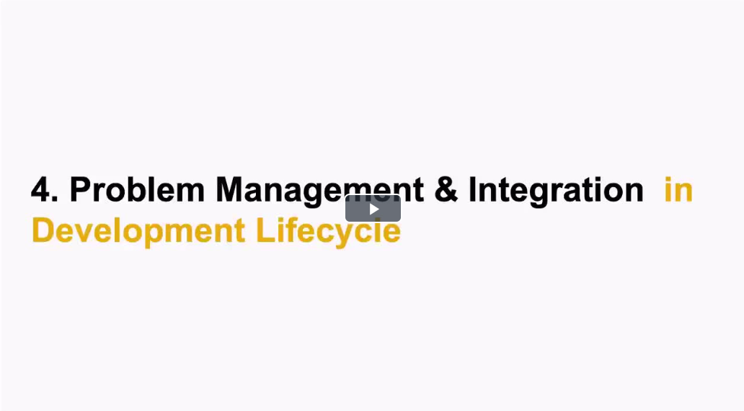
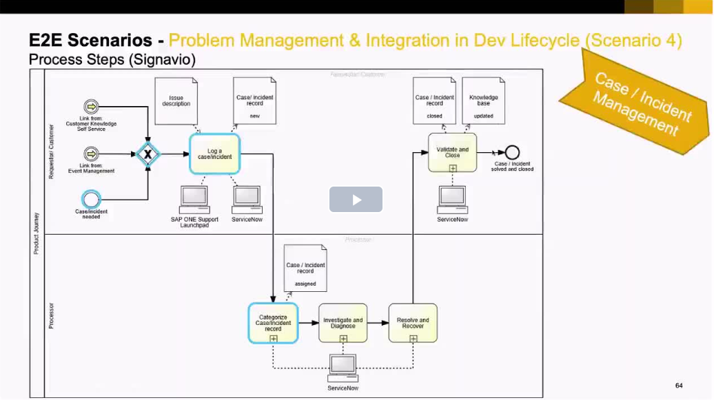
Harmonized Customer Service Management (HCSM) Terminology
Description
Explanation & Related Terms
Explanatory documents
Description
This document explains the terms Problem Record, Problem Management, Root Cause, and Root Cause Analysis.
Definition
Problem Record: Problem record (commonly used as Problem) is the entity that contains all the details of the root cause of one or more incidents or cases and such root cause is usually unknown at the time when a problem record is created.
Problem Management: Problem Management is the process responsible for managing the lifecycle of all problems. The primary objectives of problem management are to prevent cases/incidents from happening and to minimize the impact of cases/incidents that cannot be prevented.
Root Cause: Root cause is the underlying or original cause of an issue.
Root Cause Analysis (RCA): Root Cause Analysis is a problem-solving method, which focuses on uncovering the root cause(s) of an issue rather than dealing with symptoms. RCA typically, but not exclusively, concentrates on IT infrastructure failures.
Issue: Issue is any kind of circumstance that generally needs a follow-up, but has not been categorized as any kind of record type.
Problem Management Scenario Explained
Audience
Development and Operations
Prerequisites
Click on the picture to open the video
Refer to the Quick Reference Card for Case/Incident & Knowledge
Problem Management Process in Signavio
Overview
Context
Problem record can be created out of an incident record or case record in order to find a long-term solution for an issue.
Click on the picture to open the video

Slide 8
Stay connected and updated
HCSM Jam page
SAPedia
SAPterm.com

